Slide 1
2D Finite Elements
Time-dependent solution
Version 2017.1

Slide 2
Mass matrix calculation
The calculation of the mass matrix follows a logic similar to the one used for the stiffness matrix:
For each triangle e
For each local vertex i ( 1 → 3)
ii=Dof Numbering(i)
If vertex ii is unknown
For each local vertex j ( 1 → 3)
jj=Dof Numbering(j)
If vertex jj is unknown
M(ii,jj)=M(ii,jj)+rho(e)*Area(e)‏*(1+δ(i,j))/12
1
Dx₃
Dy₃
2
Dy₂
e
Dy₁
Dx₂
3
Dx₁

Slide 3
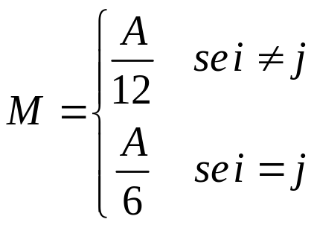
Mass matrix calculation
function M = buildMass(Me)
V =Me.Triangles.Vertices; Dof =Me.Nodes.Dof; numDof =max(Dof);
Areas=Me.Triangles.Areas; Mcontr=Me.MatrixContributions;
pos = 1; row = zeros(Mcontr, 1); col = zeros(Mcontr, 1);
m = zeros(Mcontr, 1); rho = Me.evaluateProperty('rho');
for e = 1:size(V, 1) %main loop over each triangle
for ni = 1:3 %for each vertex of this triangle
ii = Dof(V(e, ni));
if ii > 0 %is it a degree of freedom? Yes
for nj = 1:3 %second loop
jj = Dof(V(e, nj));
if jj > 0 %add to the mass matrix
m(pos) = 1/12 * Areas(e) * rho(e) * ...
((ii == jj) + 1);
row(pos) = ii; col(pos) = jj; pos = pos + 1;
end
end
end
end
end
M = sparse(row, col, m, numDof, numDof);

Slide 4
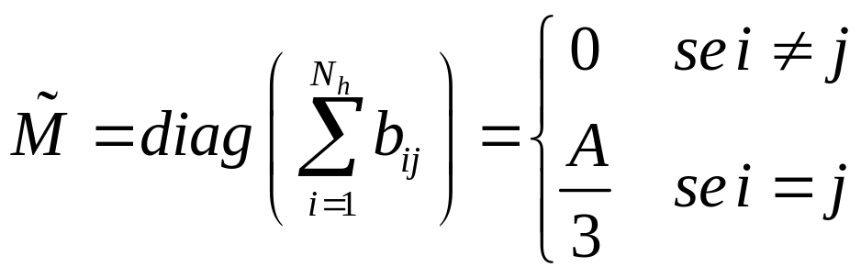
Mass matrix calculation
The lumping technique allows to build a diagonal mass matrix: we use therefore a vector to store the data
This approach is particularly convenient when we use Explicit Euler method
function M = buildMassLumping(Me)
rho = Me.evaluateProperty('rho');
V=Me.Triangles.Vertices;
Dof=Me.Nodes.Dof;
NumDof = max(Dof);
M = zeros(NumDof,1);
for e=1:size(Tr,1)
for ni=1:3
ii = Dof(V(e,ni));
if ii > 0
M(ii) = M(ii) + Areas(e) / 3 * rho(e);
end
end
end

Slide 5
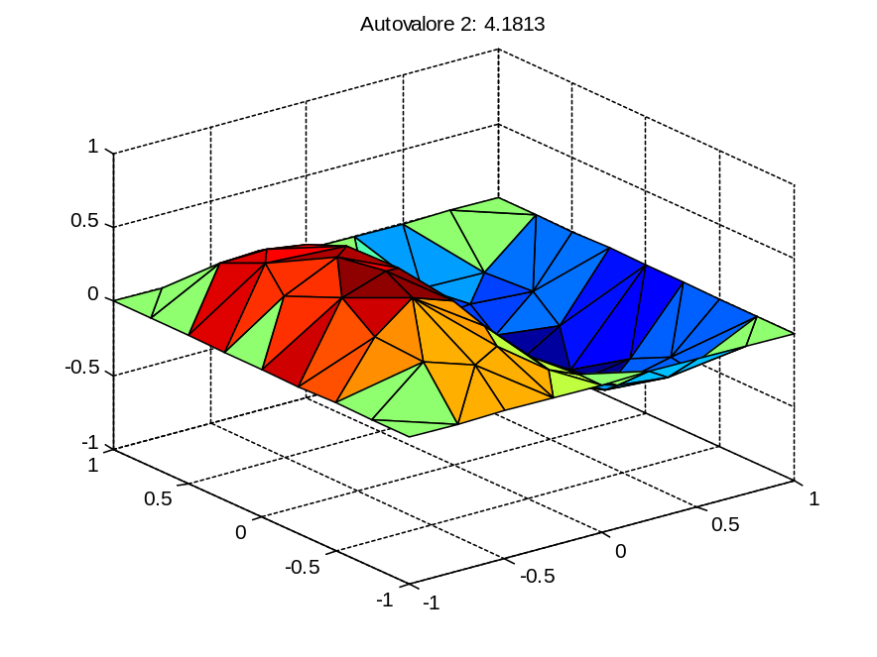
Eigenfunctions evaluation
We need to calculate the eigenvalues of M⁻¹A
Specific algorithms exist, which allow to calculate eigenvalues and eigenvectors without calculating the inverse of M
They are implemented, e.g., in the function eigs
[V,E]=eigs(A,M,2,'SM');

Slide 6
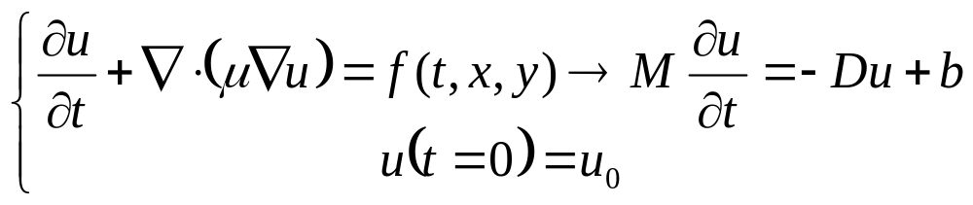
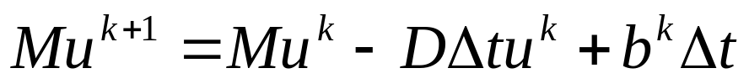
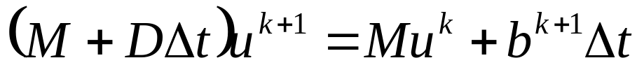
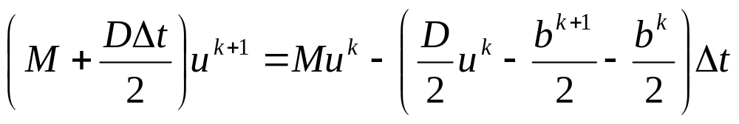
Temporal analysis
When we consider a first order time derivative, we can use the well known integration methods, with M mass matrix
Explicit Euler:
→ convergence problems if dt too large
Implicit Euler:
CN:

Slide 7
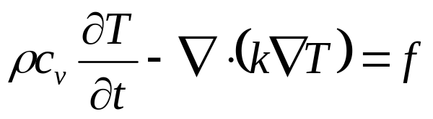
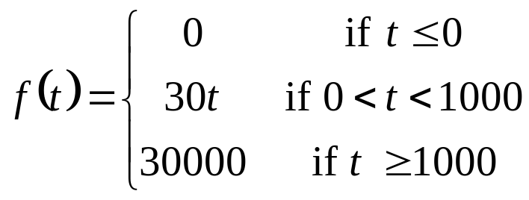
Example #1: heating of a squared domain
We study the temporal evolution of the temperature on an rectangular aluminium plate with a hole in the middle; the following B.C.s are applied
  Homogeneous Neumann on two opposite external sides (perfect insulation)
  Homogenerous Dirichlet on the two other external sides
  Dirichlet, with a temperature of 20°C on the internal edges
For the considered material we have
  density ρ: 2700 kg/m³
  specific heat capacity c_{v}: 896.9 J/(kg K)
  thermal conductivity k: 237 W/(m K)
An external source is applied:

Slide 8
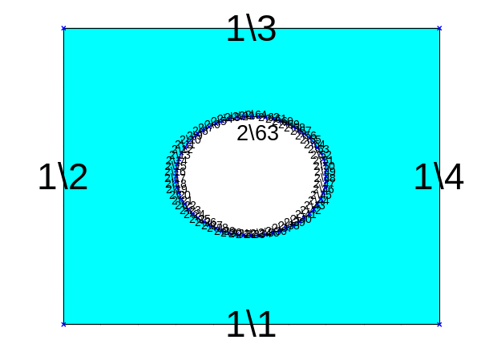
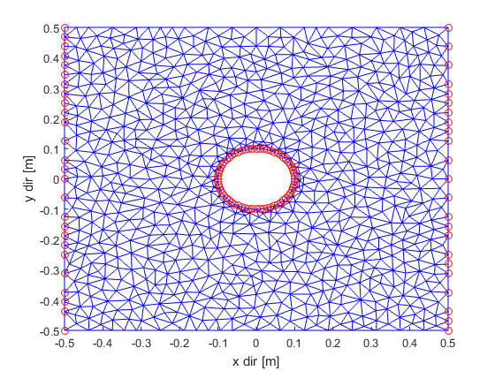
Example #1: definition of geometry, B.C. and mesh
S=regions.rect('mu', 237/2700/897)- regions.circle([0,0],[0.2,0.2],64);
figure;Sh.draw('e');
Sh.Borders(1).Bc([1,3]) =
boundaries.neumann(0);
Sh.Borders(2).Bc(:) =
boundaries.dirichlet(20);
figure;Sh.draw('bc');
Me=mesh2D(S,0.001);
figure;Me.draw('d');

Slide 9
function [D, bBoundary, bExt] = heatEquationExtForce_BuildStiff(Me,f)
We need to “split” the constant terms vector in two parts: b=bBoundary+bExt(t)
  bBoundary, related to the BC.s, is constant, since the applied BC.s do not change with respect to time
  bExt is time dependant and follows the assigned law
if ii > 0 %dof, second loop on the vertices
for nj=1:3
jj = Dof(V(e,nj)); %is it unknown as well?
if jj > 0 ...
else
val=Me.BC.DirichletNodes(-jj,2);
bBoundary(ii) = bBoundary(ii) - dtmp*val;
end
end
bExt(ii) = bExt(ii) + Areas(e)*force(e)/3.0;
end

Slide 10
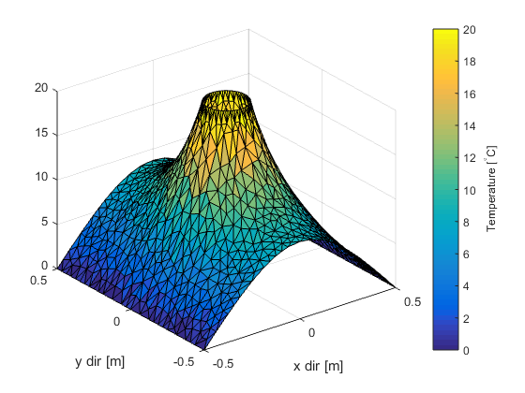
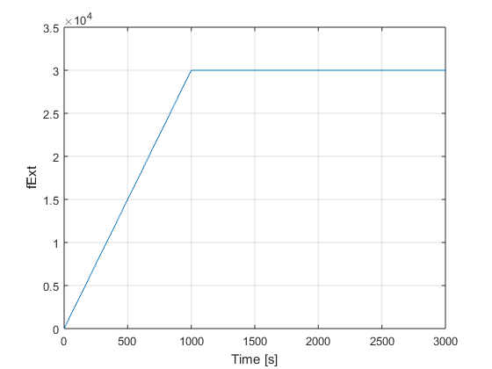
Example #1: Initial solution, f=0
f0 = @(x,y)ones(size(x)); %assume f0=1
[D,bBorder,bExt]=heatEquationExtForce_BuildStiff(Me, f0);
InitialForce = 1000; %force is 1000*f0
uStationary0 = D\(bBorder+bExt*InitialForce);
uu = Me.copyToAllNodes(uStationary0);
figure;
Me.draw(uu);
ylabel('Temperature [^\circC]');
colorbar();
M=buildMass(Me);
Tend=4000; %end time, in s
f=@(t)InitialForce+(t<1000)*(30*t) +(t>=1000)*30000;
figure;fplot(f,[0,100]);

Slide 11
Example #1: Temporal evolution
All the discussed methods follow the following steps:
  Choice of the time step, e.g. dt = 0.1;
  Definition of the initial temperatures u = uStationary0;
  Temporal loop: for k = 1:Tend/dt,
  Save indices of the nodes which are dof: Dofs=Me.Nodes.dof>0;
  In each time considered step:
    calculate the new force T4=f(t);
    Solve the linear system to calculate the new solution
    u=…………………
    uu(Dof) = u; %update only dofs, it’s faster!
    (if required) redraw the solution, for instance with
    Me.draw(uu,'hidemesh');%I hide the mesh
    title(['t= ' num2str(t) 's']); %elapsed seconds
    zlim([0 20]); %fixed vertical range
    caxis([0 20]); %fixed color scale
    view ([0 90]); %top view
    drawnow(); %force MATLAB to immediately redraw

Slide 12



Esplicit Euler method (EE)
dt=0.1;
u=uStationary0;
Ddt=D*dt;
for k=1:Tend/dt,
t=k*dt;
F=f(t-dt); %previous step!
u=u-M\(Ddt*u-dt*(bBoundary+bExt*F));
uu(Dofs)=u;
Me.draw(uu,'hidemesh'); hold off;
zlim([0,20]);
caxis([0,20]);
view([0,90]);
title(['t=',num2str(t) 's']); drawnow();
end
NB! Please pay attention to the correct choice of dt: with largest eigenvalue, in module, of , to be calculated as eigs(A,M,1,'LM') and NEVER taking the inverse of M!

Slide 13
Implicit Euler method (IE)
dt = 0.1;
u = uStationary0;
S = (M+D*dt);
for k=1:Tend/dt,
t = k*dt;
F = f(t); %current step!
u = S\(M*u+dt*(bBoundary+bExt*F));
uu(Dofs) = u;
Me.draw(uu,'hidemesh');
hold off;
zlim([0,20]);
caxis([0,20]);
view([0,90]);
title(['t=',num2str(t) 's']);
drawnow();
end

Slide 14
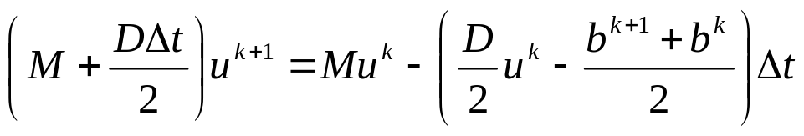
Crank-Nicholson method (CN)
dt=10;
u=uStationary0;
B=D*dt/2; CN1=M+B; CN2=M-B;
Fold=f(0);
for k=1:Tend/dt,
t=k*dt;
F=f(t);
u=CN1\(CN2*u+dt*(bBoundary+bExt*(F+Fold)/2));
uu(Dofs)=u;
Me.draw(uu,'hidemesh');
hold off;
zlim([0,20]);
caxis([0,20]);view([0,90]);
title(['t=',num2str(t) 's']);drawnow();
Fold=F;
end

Slide 15
Temporal evolution
At every time step, we need to solve a linear system that allows to calculate the new approximation of the solution
If the mass matrix (EE) or both the stifness and mass matrices (IE, CN) do not change in time, it is generally very efficient to evaluate their preconditioners (see functions ilu and ichol).
This approach, used in conjunction with an iterative method starting from the solution at the previous step, can significantly reduce the required computation time

Slide 16
Implicit Euler method (IE) with preconditioning
dt = 0.1;
u = uStationary0;
S = (M+D*dt);
%u=S\(M*u+bdt*T4); since at each step I must solve the %system Su=..., then I pre-factor S
opt = struct('type','ict','droptol',1e-4);
R = ichol(S,opt);
for k=1:Tend/dt,
t = k*dt;
F = f(t);
[u, flag] = pcg(S,M*u+dt(bBoundary+bExt*F),
1e-6,1000,R',R,u);
uu(Dofs) = u;
Me.draw(uu,'hidemesh');zlim([0,20]);
caxis([0,20]);view([0,90]);
title(['t=',num2str(t) 's']);drawnow();
end
NB: to estimate the time reduction, do not draw the solution!

Slide 17
ODExx functions
The syntax is the same for all the functions of the family
[t,y]=ode45(dydt,[T0, Tend], y0, odepar)
t column vector of N components containg the time values the solution was calculated
y matrix of N rows, each one containing the solution calculated at the corresponding time step indicated in the t vector
dydt function to integrate. It MUST receive two input parameters, (time and y), like dydt=@(t,y)siny)+t
[T0, Tend] 2 components vector, indicating the initial and final integration time
y0 problem initial values
odepar optional variable created by the odeset function to set additional integration parameters such as relative or absolute tolerances, mass matrix, maximum time step,...
odepar=odeset('Absrel',1e-6,'AbsTol',1e-3', 'NonNegative',1, 'MaxStep',1e-1, 'Mass',M);

Slide 18
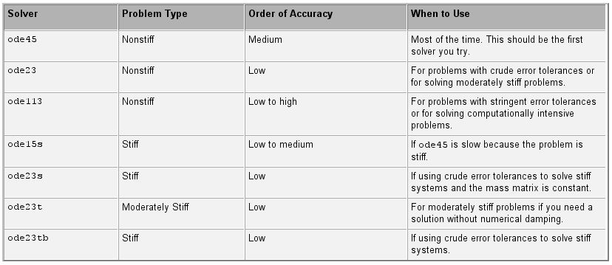
ODExx functions
In MATLAB, to numerically integrate (systems of) differential equations the odexx functions are available
All these functions have the same calling syntax, but implement different algorithms

Slide 19
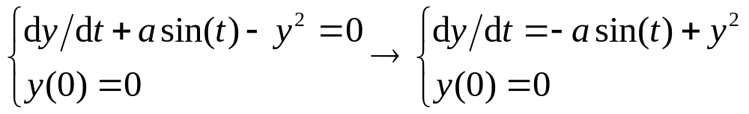
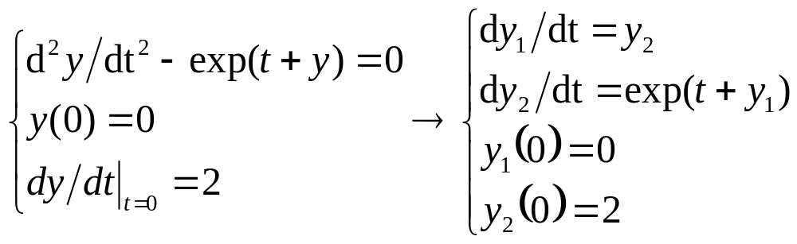
ODExx functions: examples
Let’s consider some examples of Cauchy problems integrated over the interval [0,1]
>>[t,y]=ode45(@(t,y)-a*sin(t)+y.^2,[0,1],0);
>>[t,y]=ode45(@(t,y)[y(2);exp(t+y(1)),[0,1],[0;2]);

Slide 20
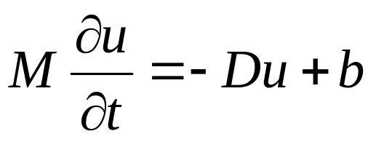
Example #1:
ODExx functions
u0 = uStationary0;
figure;
fode = @(t,u)-D*u+(bBoundary+bExt*f(t));
odepar = odeset('Mass',M); %Mass matrix
[t,U] = ode45(fode, [0,Tend],u0,odepar);
size(U) % 24809 x 769 -> 769 time steps
for k = 1:10:length(t) %now simply plot the solution
uu(Dofs) = U(k,:);
Me.draw(uu,'hidemesh');
zlim([0 TMax]);
caxis([0 TMax]);
% view([0 90]);
title(['t= ' num2str(t(k)) 's']);
drawnow();
end

Slide 21
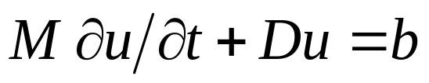
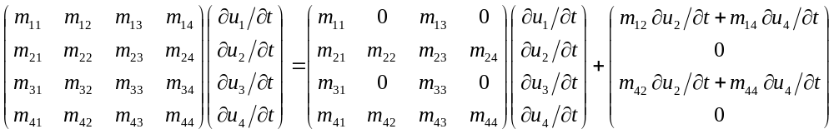
Time varying Dirichlet B.C.s
Let’s consider the system with M and D built on all the nodes (and not only the internal ones)
Let nodes 1 and 3 be dof, node 2 a node on an edge with time invariant Dirichlet B.C (u₂) and node 4 on an edge with a time-varying Dirichlet B.C. (u₄(t))
Moving to the system involving only the dof we finally have
We need to take into account this additional contribution

Slide 22
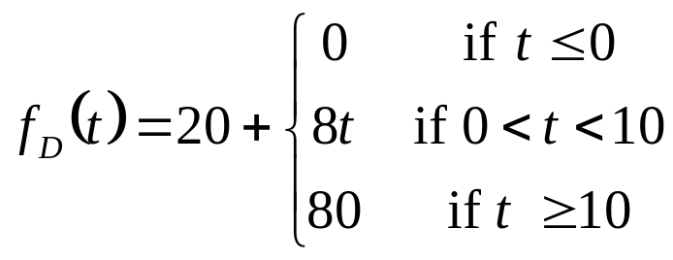
Example #2: heating of a squared domain
We study the same problema as Example#1 but the following B.C.s are now applied:
  Homogeneous Neumann on two opposite external sides (perfect insulation)
  Non homogeneous Dirichlet on the two other external sides, where T=20°
  Dirichlet on the internal edges, with the law
No external source is applied

Slide 23
Example #2: definition of geometry, B.C. and mesh
S=regions.rect('mu', 237/2700/897)- regions.circle([0,0],[0.2,0.2],64);
figure;Sh.draw('e');
Sh.Borders(1).Bc([1,3]) =
boundaries.neumann(0);
Sh.Borders(2).Bc(:) =
boundaries.dirichlet(1);
figure;Sh.draw('bc');
Me=mesh2D(S,0.001);
figure;Me.draw('d');

Slide 24

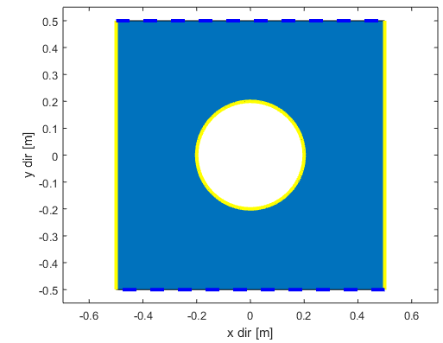
Example #2
We need to split vector b into a constant term and a time varying term (for the nodes on the internal border)
Moreover, we need to generate a proper vector m_{var} to take into account the contribution from the Mass matrix
Which nodes are proving a time-varying Dirichlet B.C.? Depending on the geometry and on the B.C.s, many tests are generally possible; in this
case it’s sufficient to check if |x|<=0.2
DirichletNodesCircle=
Me.find(@(x,y)abs(x)<=0.2,'d');
DirichletNodesExtBorder =
Me.find(@(x,y)abs(x)>0.2,'d');
NB: additional b contributions are required if
different laws are applied to the domain edges
and if external forces are applied
N
D
D
D
N

Slide 25
Example #2: stiffness matrix
function [D,bconst,bvar]=heatEquationVariableDirichlet_BuildStiff(Me)
V=Me.Triangles.Vertices;Areas=Me.Triangles.Areas;Nodes=Me.Nodes;
Dof=Me.Nodes.Dof; numDof = max(Dof);
bconst = zeros(numDof,1); bvar = zeros(numDof,1);
for e=1:N_Tr
...
for ni=1:3
ii = Dof(V(e,ni));
if ii > 0
for nj=1:3
jj = NI(Tr(e,nj));
d=c(e)*(Dy(ni)*Dy(nj)+Dx(ni)*Dx(nj))/(4.0*Areas(e)) ;
if jj > 0, ...
else %Non homogeneous Dirichlet B.C.
val=Me.DirichletNodes(-jj,2);
if abs(Me.Nodes.Y(V(e,nj)))<=0.2 %inner circle?
bvar(ii) = bvar(ii) - dtmp*val ;
else
bconst(ii) = bconst(ii) - dtmp*val ;
end
end
end
end , end, end

Slide 26
Example #2: mass matrix
function [M, mvar] = buildMassVariableDirichlet(Me)
V =Me.Triangles.Vertices; Dof =Me.Nodes.Dof; numDof =max(Dof);
Areas = Me.Triangles.Areas;
mvar = zeros(numDof, 1);
for e = 1:size(V, 1) %main loop over each triangle
for ni = 1:3 %for each vertex of this triangle
ii = Dof(V(e, ni));
if ii > 0 %is it a degree of freedom? Yes
for nj = 1:3 %second loop
jj = Dof(V(e, nj));
if jj > 0 %add to the mass matrix
...
else
if abs(Me.Nodes.Y(V(e,nj)))<=0.2 %circle?
mvar(ii)=mvar(ii)+mtmp;
end
end
end
end
end
end

Slide 27
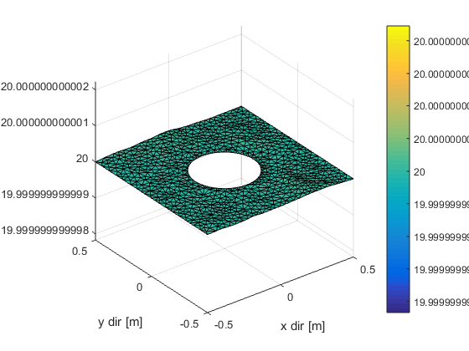
Example #2: stationary solution
We solve the linear system in order to obtain the initial distribution
of the temperature:
[D,bconst,bvar]=heatEquationVariableDirichlet_BuildStiff(Me);
T0=20; %initial temperature on the internal border
uStationary0=D\(bconst+bvar*T0);
uu=zeros(size(Me.Nodes.X));
uu(Dof>0)=uStationary0;
uu(DirichletNodesCircle)=T0;
uu(DirichletNodesExtBorder)=20;
Since all the Dirichlet edges have a T=20°C
and there is no external contribution, the
temperature in each node of the domain
is exactly 20°C.

Slide 28
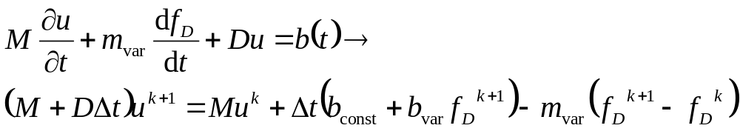
Example #2: temporal evolution
Using the Implicit Euler method:
Therefore:
[M, mvar] = buildMassVariableDirichlet(Me);
u=uStationary0; dt=1; A=(M+D*dt); TCircleOld=fDirichlet(0);
for k=1:Tend/dt,
TCircle=fDirichlet(k*dt); DeltaT=Tcircle-TCircleOld;
u=A\(M*u+dt*(bconst+bvar*TCircle)-mvar*DeltaT);
uu(Dof)=u;
uu(DirichletNodesCircle)=TCircle;
TCircleOld=TCircle;
end

Slide 29
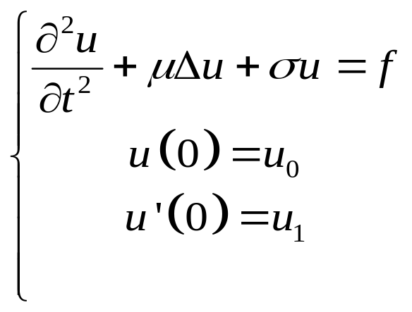

Temporal analysis of elliptic problems
Let’s consider the temporal evolution of the elastic membrane (elliptic problem)
We obtain the following system
with M mass matrix, D diffusion term and R reaction term
For simplicity, we assume constant B.C.s

Slide 30
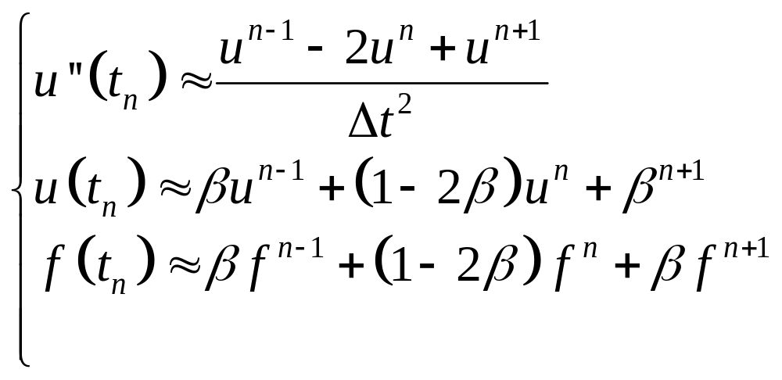
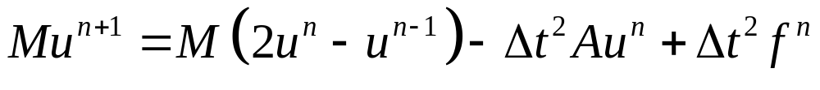
Newmark method
We introduce the following approximations
The accuracy is always of the second order, while the method is unconditionally stable only if β =1/4
When β =0 we have an explicit method very easy to implement in MATLAB (see RunDT and RunDTLum)

Slide 31
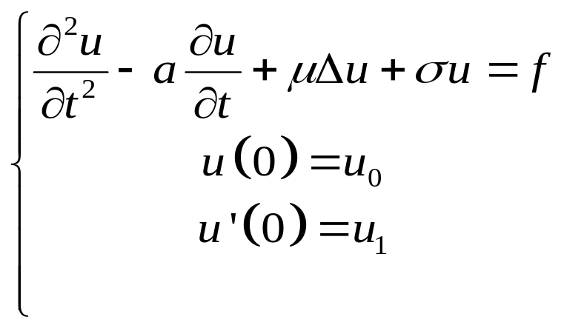
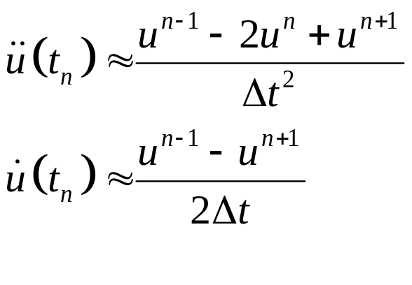
Viscous friction
A term describing the viscous friction can be introduced approximating the first order derivative with the incremental ration
When β=0, the system is then

Slide 32
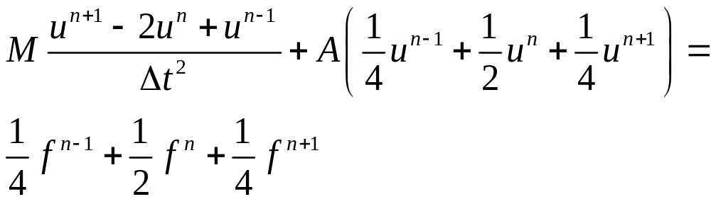
Neumark method (β=1/4)‏
We have to evaluate at each time step the quantity
This is therefore an implicit method

Slide 33
Example: script RunDt
We study the evolution of the position of a squared membrane placed in a viscous fluid, starting from a zero displacement, when a constant force is applied from t=0
Sh = regions.rect('mu',1);
Me = mesh2D(Sh);
f = @(x,y)-4*ones(size(x));
[D,b] = dirichletHomo_BuildStiff(Me,f);
M = buildMass(Me);
uu = Me.copyToAllNodes(u, pcg(A,b,1e-3,250));
%well known stationary solution
figure;
Me.draw(uu,'hidemesh');
Dofs = Me.Nodes.Dof>0;

Slide 34
Example: script RunDt
%Numerical evolution, dumped oscillation
dt = 0.01; %time steps
Tend = 10; %simulation end time
NumIter = ceil(Tend/dt); %number of steps displ=zeros(NumIter,1); %to store the max displacement
u0 = zeros(size(b)); %null initial displacement
u1 = u0;
a = 1.5; %fluid friction coefficient
for i = 1:NumIter [u2,flag]=pcg(M*(1+a*dt),M*((2+a*dt)*u1-u0)- dt^2*(D*u1-b),[],30,[],[],u1);
u0=u1; u1=u2;
uu(Dofs)=u2;
Me.draw(uu,'hidemesh'); zlim([-1 1]);
drawnow; %to force a refresh of the figure, %otherwise it is updated at the end of the loop
displ(i)=max(abs(u2)); %save the maximum displac.
end

Slide 35
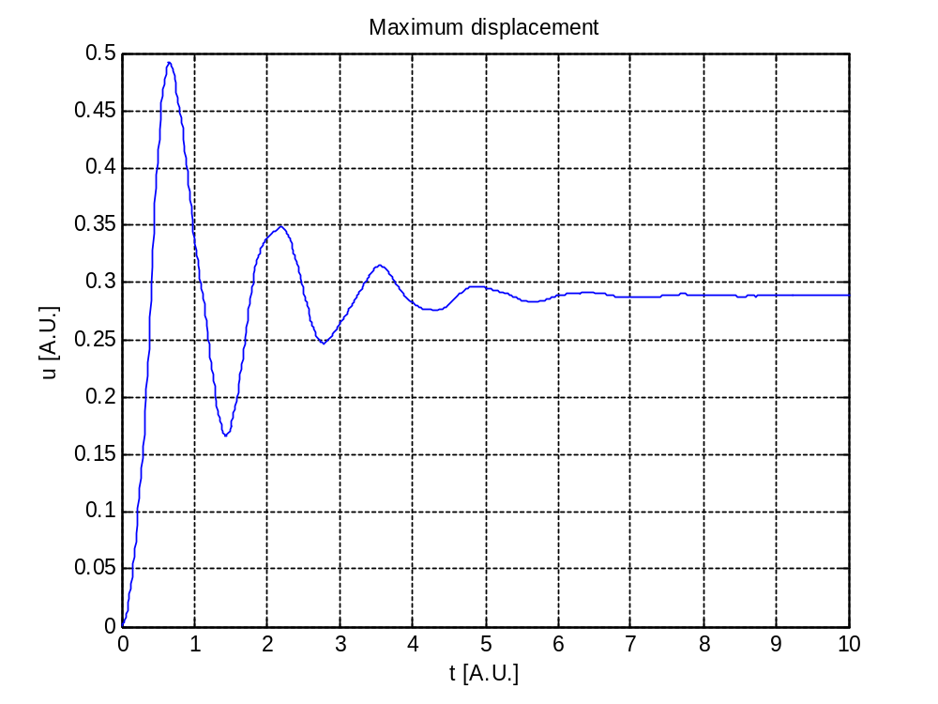
Example: script RunDt
figure;
plot((1:NumIter)*dt, displ);
title('Maximum displacement');
xlabel('t [A.U.]');
ylabel('u [A.U.]');
grid on;

Slide 36
Summary of BuildStiff/Mass functions
File | Boundary conditions
dirichletHomo_BuildStiff | Homogeneous Dirichlet, homogeneous Neumann
dirichletNonHomo_BuildStiff | Non homogeneous Dirichlet, homogeneous Neumann
neumannNonHomo_BuildStiff | Homogeneous Dirichlet, non homogeneous Neumann
robin_BuildStiff | Homogeneous Dirichlet, homogeneous Neumann, Robin
dirichletHomo_DiffTransReact_BuildStiff | Homogeneous Dirichlet, homogeneous Neumann
periodic_BuildStiff | Homogeneous Dirichlet, homogeneous Neumann, periodic
coupledDirichlet_BuildStiff / coupledNeumann_BuildStiff | Non homogeneous Dirichlet, homogeneous Neumann
buildMass / buildMassLumping | -

